Slide 1
APPLICATIONS OF DATA SCIENCE: CASE STUDIES ACROSS INDUSTRIES
Exploring How Data Science Transforms Healthcare, Finance, and Marketing

Slide 2
Introduction to Data Science
The simplest definition of data science is the extraction of actionable insights from raw data.
Data science is a deep study of the massive amount of data, which involves extracting meaningful insights from raw, structured, and unstructured data that is processed using the scientific method, different technologies, and algorithms. (NILU S. 2020)

Slide 3
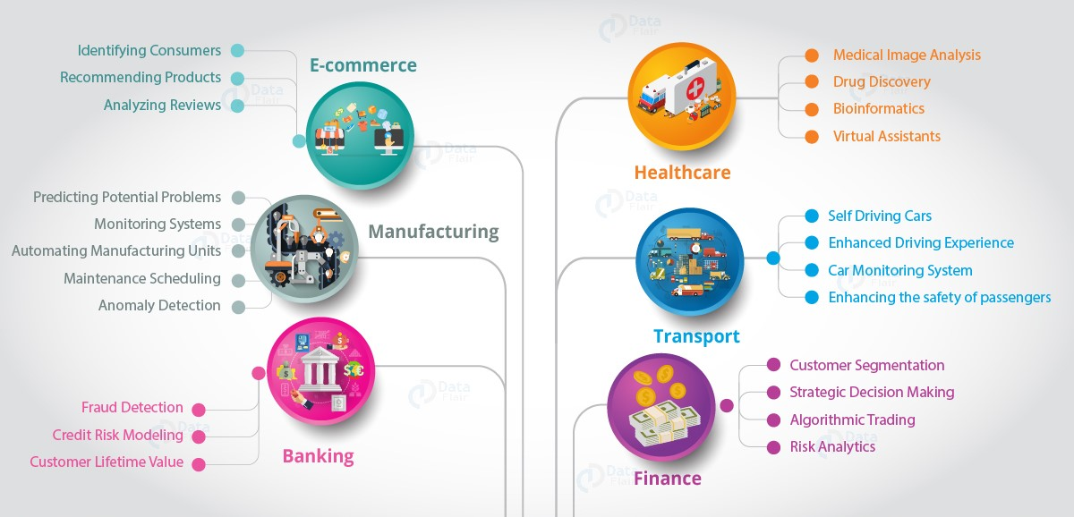
Application of Data Science

Slide 4
E-commerce
Banking
Healthcare
Banking
Gaming
Transport

Slide 5
Data Science In E-commerce
When you shop online from a particular merchant for the first time, you handpick a few items you really like. The successive searches you do to buy again in future reveals a nice selection of products which you both find appealing and valuable.
In reality, this is big data e-commerce and data science e-commerce at work. ML (machine learning) algorithms have actually handpicked those items for you, because they have learned from the choices you made when buying products and what you searched for.
CASE STUDY:
Amazon, the e-commerce giant, heavily relies on data science to personalize the shopping experience for its customers. They use algorithms to analyze customers' browsing and purchasing history, making product recommendations tailored to individual preferences. This approach has contributed significantly to Amazon's success and customer satisfaction by reducing customer service response times by 40%.
Additionally, Amazon leverages data science for:
A study found that Amazon's personalized shopping experience has resulted in a 68% improvement in click-through rates on recommended products compared to non-personalized suggestions.

Slide 6
Data Science In Healthcare
Health care has a long tradition of utilizing research and in-depth data analysis to generate new insights into disease progression, drug development and more. Modern health care has shifted its focus to leveraging massive amounts of available data to improve patient outcomes and quality of care. Health care data science efforts are also prioritizing patient care initiatives.
Using emerging tools and technologies such as artificial intelligence, machine learning and predictive analytics, data scientists are now able to harness the insights and power of existing and future health care data.
CASE STUDY:
IBM Watson Health employs data science to enhance healthcare by providing personalized diagnostic and treatment recommendations. Watson's natural language processing capabilities enable it to sift through vast medical literature and patient records to assist doctors in making more informed decisions.
Data science has significantly aided IBM Watson Health in healthcare diagnostics and personalized treatment in:
IBM Watson Health has demonstrated a 15% increase in the accuracy of cancer diagnoses when assisting oncologists in analyzing complex medical data, including genomic information and medical journals.

Slide 7
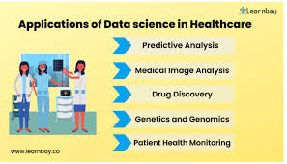

Slide 8
Data Science In Finance
Data science can be applied to finance in several ways, An example include fraud prevention
Fraud Prevention: Traditional fraud detection uses rule-based models that identify unusual transactions. These models often flag legal transactions based on broken rules or fraudulent activities when millions of transactions are happening at the same time. By contrast, machine learning creates algorithms that process large datasets with many variables to find hidden correlations between user behavior and the likelihood of fraudulent actions.
CASE STUDY:
PayPal, a leader in online payments, employs advanced data science techniques to detect and prevent fraudulent transactions in real-time. They analyze transaction data, user behavior, and other relevant factors to identify suspicious activity.
Here's how data science has helped PayPal in this regard:
PayPal's real-time fraud detection system reported an impressive 99.9% accuracy rate in identifying and blocking fraudulent transactions, minimizing financial losses for both the company and its users.
In a recent report, PayPal reported that their proactive fraud prevention measures saved users an estimated $2 billion in potential losses due to unauthorized transactions in a single year.

Slide 9
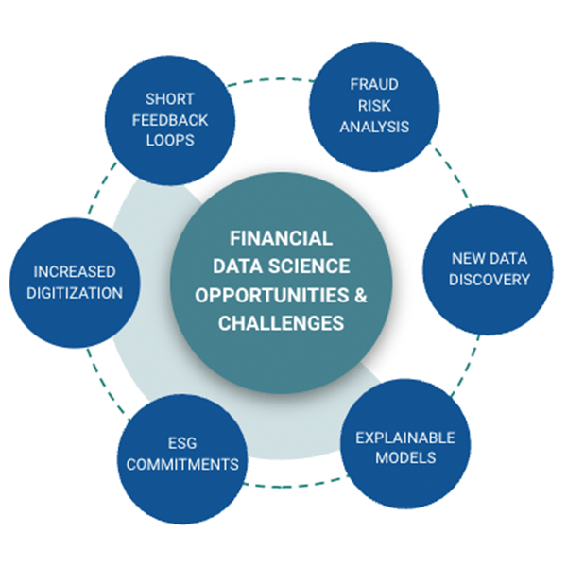

Slide 10
Data Science in Gaming
The gaming industry has evolved rapidly over the past few decades, transforming from simple arcade games to complex, immersive experiences available on various platforms. A critical driver behind this transformation is data science, which leverages large datasets to enhance game development, player engagement and revenue generation.
Case Study: Electronic Arts (EA)
Electronic Arts (EA) is a leading game developer known for titles like FIFA and Madden NFL. EA uses data science to analyze player behavior and feedback, allowing them to make data-driven decisions about game updates and new features. For example, by analyzing in-game data, EA can identify which features are most popular and which ones need improvement, leading to a more engaging gaming experience.
EA’s use of telemetry data, which involves tracking every button press, movement and decision made by players, provides deep insights into how games are played. This data helps in understanding player engagement, identifying bugs and optimizing game balance. EA also leverages machine learning algorithms to predict player behavior, which informs the development of new game modes and features that are likely to resonate with players.
EA's approach extends to their online multiplayer games, where matchmaking algorithms ensure fair and competitive play by pairing players of similar skill levels. This not only enhances player satisfaction but also fosters a more vibrant and engaged gaming community.

Slide 11
REFERNCES
Nilu Singh (2020 June) Introduction To Data Science https://www.researchgate.net/publication/342640553_Introduction_of_Data_Science
Thomas Wood (2023 November) Data Science and E-commerce – The 2023 Guide https://fastdatascience.com/ai-for-business/data-science-e-commerce/
Aditya Sharma (2019) Top 10 Real-World Data Science Case Studies https://www.turing.com/resources/data-science-case-studies#case-study-5:-e-commerce-personalization-and-recommendation-systems
Johnathan Mark (2022) How Data Science is Reshaping Health Care https://onlinedegrees.sandiego.edu/data-science-health-care/
Kaplan Schweser (February 13, 2024) Applying Data Science in Finance https://www.schweser.com/cfa/blog/career-information/data-science-in-finance
Rohan Whitehead (2024 May) Data Training Specialist https://ioaglobal.org/blogdetails/role-of-data-science-in-gaming-industry/

